Slide 1
Strings and Character Classes in Java

Slide 2
The String Class
Constructing a String:
  String message = "Welcome to Java“;
  String message = new String("Welcome to Java“);
  String s = new String();
Obtaining String length and Retrieving Individual Characters in a string
String Concatenation (concat)
Substrings (substring(index), substring(start, end))
Comparisons (equals, compareTo)
String Conversions
Finding a Character or a Substring in a String
Conversions between Strings and Arrays
Converting Characters and Numeric Values to Strings

Slide 3

Strings Are Immutable- Trace Code
animation
String s = "Java";
s = "HTML";
A String object is immutable; its contents cannot be changed. Does the following code change the contents of the string?

Slide 4
Interned Strings
Since strings are immutable and are frequently used, to improve efficiency and save memory, the JVM uses a unique instance for string literals with the same character sequence. Such an instance is called interned. For example, the following statements:

Slide 5
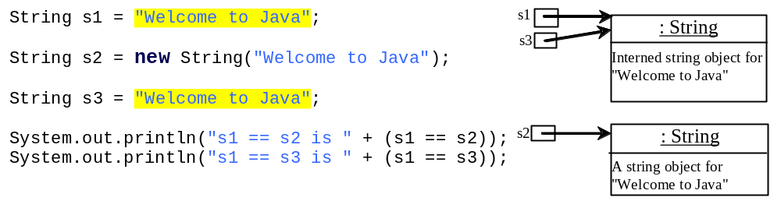
Examples
display
s1 == s is false
s1 == s3 is true
A new object is created if you use the new operator.
If you use the string initializer, no new object is created if the interned object is already created.

Slide 6
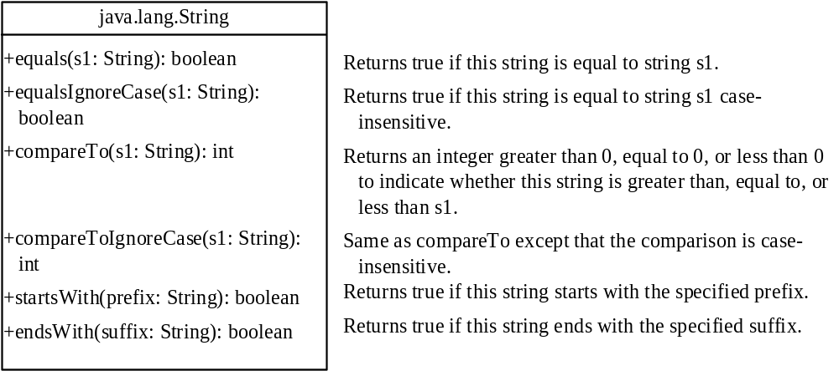
String Comparisons

Slide 7
String Comparisons
equals
String s1 = new String("Welcome“);
String s2 = "welcome";
if (s1.equals(s2)){
// s1 and s2 have the same contents
}
if (s1 == s2) {
// s1 and s2 have the same reference
}

Slide 8
String Comparisons, cont.
compareTo(Object object)
String s1 = new String("Welcome“);
String s2 = "welcome";
if (s1.compareTo(s2) > 0) {
// s1 is greater than s2
}
else if (s1.compareTo(s2) == 0) {
// s1 and s2 have the same contents
}
else
// s1 is less than s2

Slide 9
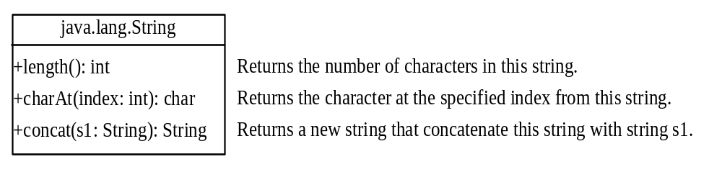
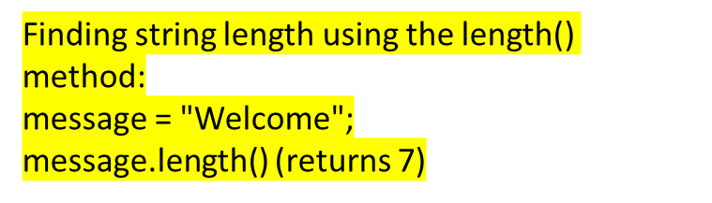
String Length, Characters, and Combining Strings

Slide 10
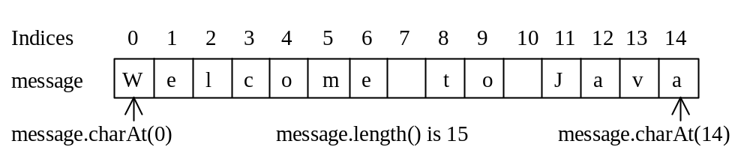
Retrieving Individual Characters in a String
Do not use message[0]
Use message.charAt(index)
Index starts from 0

Slide 11
String Concatenation
String s3 = s1.concat(s2);
String s3 = s1 + s2;
s1 + s2 + s3 + s4 + s5 same as
(((s1.concat(s2)).concat(s3)).concat(s4)).concat(s5);

Slide 12
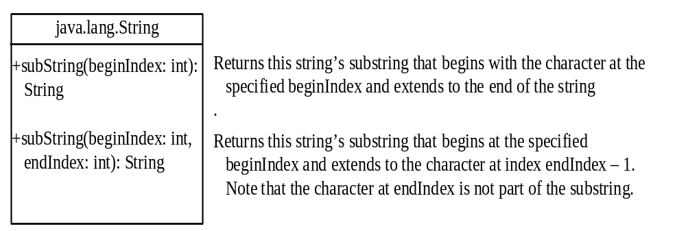
Extracting Substrings

Slide 13
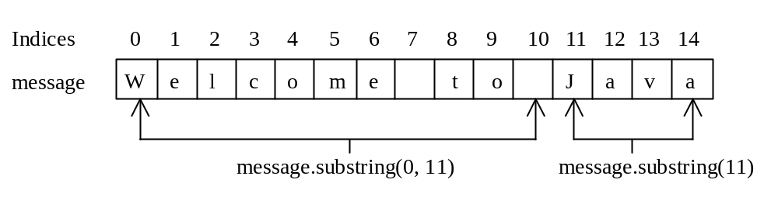
Extracting Substrings
You can extract a single character from a string using the charAt method. You can also extract a substring from a string using the substring method in the String class.
String s1 = "Welcome to Java";
String s2 = s1.substring(0, 11) + "HTML";

Slide 14
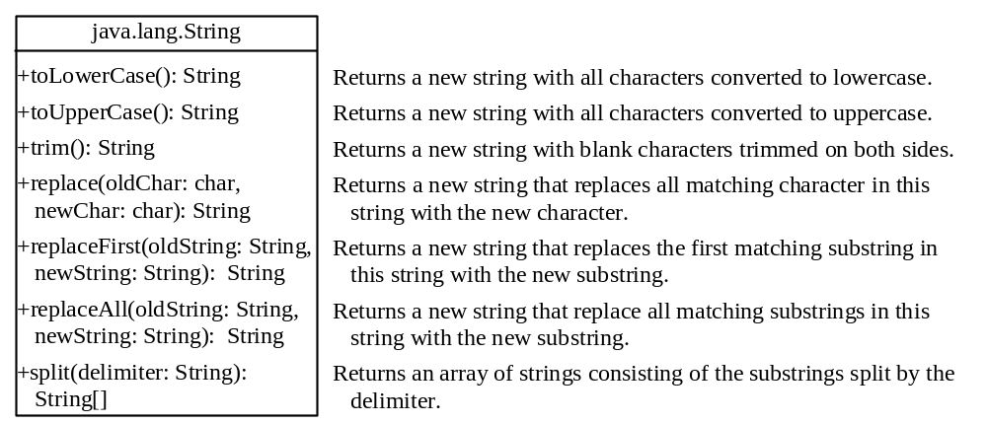
Converting, Replacing, and Splitting Strings

Slide 15
Examples
"Welcome".toLowerCase() returns a new string, welcome.
"Welcome".toUpperCase() returns a new string, WELCOME.
" Welcome ".trim() returns a new string, Welcome.
"Welcome".replace('e', 'A') returns a new string, WAlcomA.
"Welcome".replaceFirst("e", "AB") returns a new string, WABlcome.
"Welcome".replace("e", "AB") returns a new string, WABlcomAB.
"Welcome".replace("el", "AB") returns a new string, WABlcome.

Slide 16
Matching, Replacing and Splitting by Patterns
You can match, replace, or split a string by specifying a pattern. This is an extremely useful and powerful feature, commonly known as regular expression. Regular expression is complex to beginning students. For this reason, two simple patterns are used in this section.
"Java".matches("Java");
"Java".equals("Java");
"Java is fun".matches("Java.*");
"Java is cool".matches("Java.*");

Slide 17
Matching, Replacing and Splitting by Patterns
The replaceAll, replaceFirst, and split methods can be used with a regular expression. For example, the following statement returns a new string that replaces $, +, or # in "a+b$#c" by the string NNN.
String s = "a+b$#c".replaceAll("[$+#]", "NNN");
System.out.println(s);
Here the regular expression [$+#] specifies a pattern that matches $, +, or #. So, the output is aNNNbNNNNNNc.

Slide 18
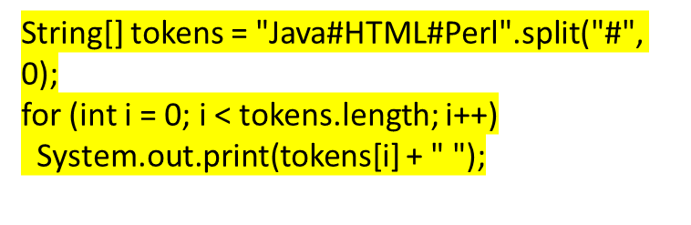

Matching, Replacing and Splitting by Patterns
The following statement splits the string into an array of strings delimited by some punctuation marks.
String[] tokens = "Java,C?C#,C++".split("[.,:;?]");
for (int i = 0; i < tokens.length; i++)
System.out.println(tokens[i]);

Slide 19
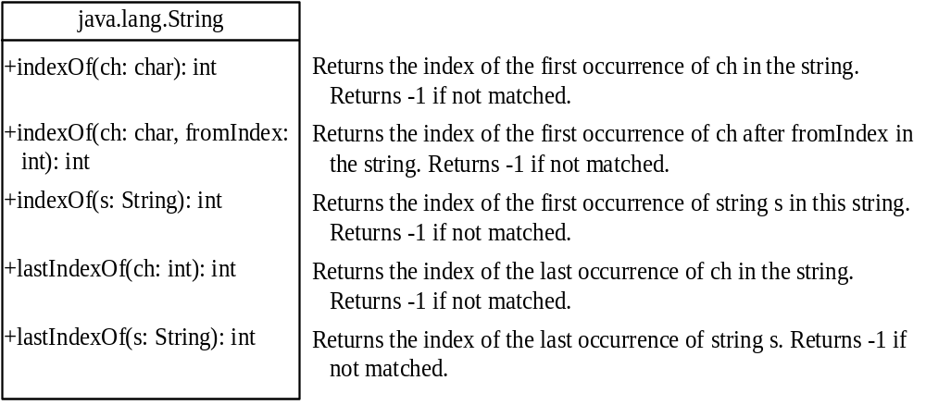
Finding a Character or a Substring in a String

Slide 20
Finding a Character or a Substring in a String
"Welcome to Java".indexOf('W') returns 0.
"Welcome to Java".indexOf('x') returns -1.
"Welcome to Java".indexOf('o', 5) returns 9.
"Welcome to Java".indexOf("come") returns 3.
"Welcome to Java".indexOf("Java", 5) returns 11.
"Welcome to Java".indexOf("java", 5) returns -1.
"Welcome to Java".lastIndexOf('a') returns 14.

Slide 21
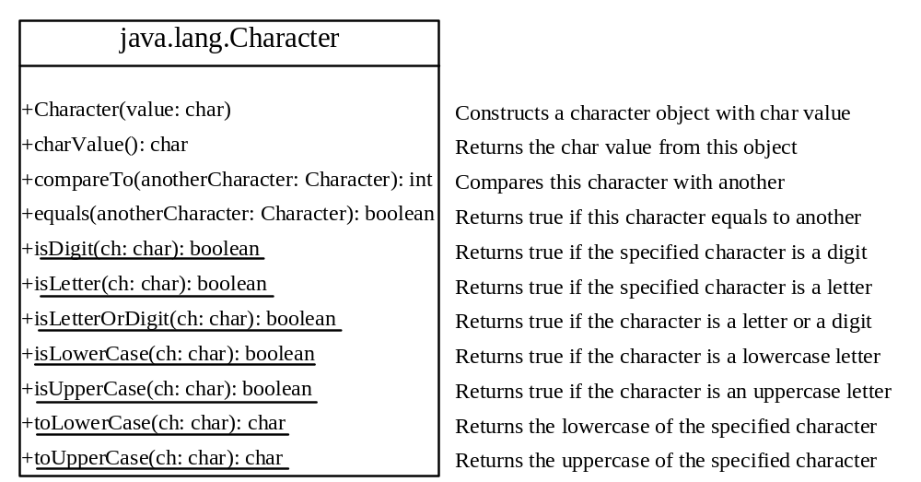
The Character Class

Slide 22
Examples
Character charObject = new Character('b');
charObject.compareTo(new Character('a')) returns 1
charObject.compareTo(new Character('b')) returns 0
charObject.compareTo(new Character('c')) returns -1
charObject.compareTo(new Character('d') returns –2
charObject.equals(new Character('b')) returns true
charObject.equals(new Character('d')) returns false

Slide 23
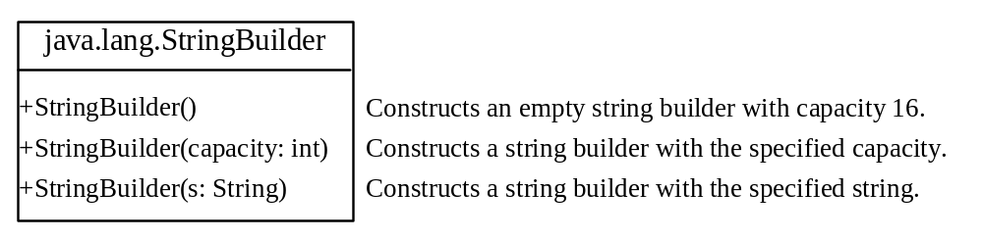
StringBuilder and StringBuffer
The StringBuilder/StringBuffer class is an alternative to the String class. In general, a StringBuilder/StringBuffer can be used wherever a string is used. StringBuilder/StringBuffer is more flexible than String. You can add, insert, or append new contents into a string buffer, whereas the value of a String object is fixed once the string is created.

Slide 24
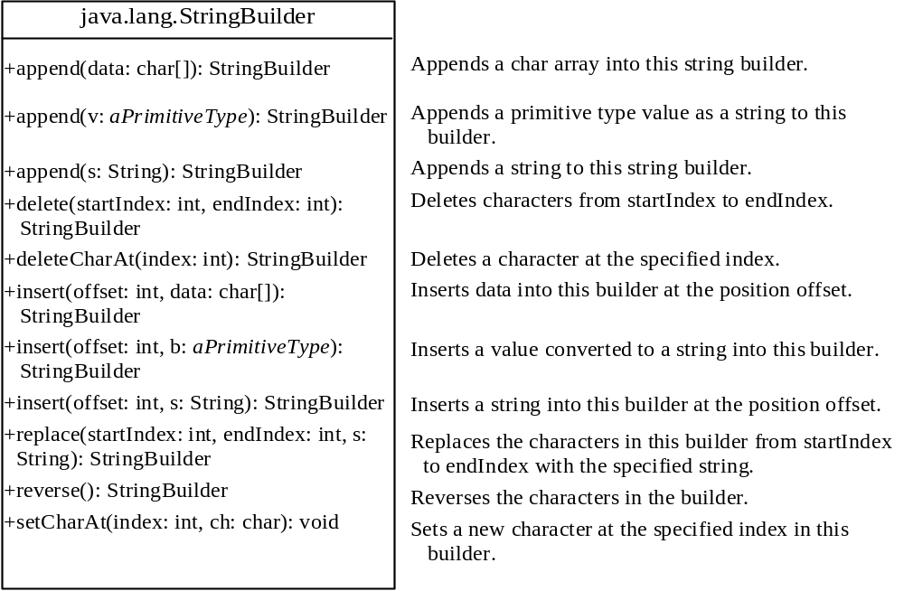
Modifying Strings in the Builder

Slide 25
Examples
stringBuilder.append("Java");
stringBuilder.insert(11, "HTML and ");
stringBuilder.delete(8, 11) changes the builder to Welcome Java.
stringBuilder.deleteCharAt(8) changes the builder to Welcome o Java.
stringBuilder.reverse() changes the builder to avaJ ot emocleW.
stringBuilder.replace(11, 15, "HTML")
changes the builder to Welcome to HTML.
stringBuilder.setCharAt(0, 'w') sets the builder to welcome to Java.

Slide 26
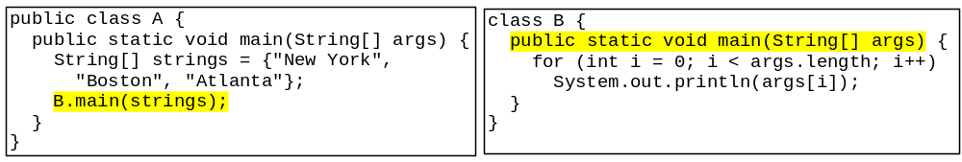
Main Method Is Just a Regular Method
You can call a regular method by passing actual parameters. Can you pass arguments to main? Of course, yes. For example, the main method in class B is invoked by a method in A, as shown below:

Slide 27
Garbage Collection
When objects are no longer needed, they should be destroyed.
This frees up the memory that they consumed.
Java handles all of the memory operations for you.
Simply set the reference to null and Java will reclaim the memory.

Slide 28
Garbage Collection
The Java Virtual Machine has a process that runs in the background that reclaims memory from released objects.
The garbage collector will reclaim memory from any object that no longer has a valid reference pointing to it.
  BankAccount account1 = new BankAccount(500.0);
  BankAccount account2 = account1;
This sets account1 and account2 to point to the same object.

Slide 29
Garbage Collection
A BankAccount object
Balance:
account1
Address
500.0
account2
Address
Here, both account1 and account2 point to the same
instance of the BankAccount class.

Slide 30
Garbage Collection
A BankAccount object
Balance:
account1
null
500.0
account2
Address
However, by running the statement: account1 = null;
only account2 will be pointing to the object.

Slide 31
Garbage Collection
A BankAccount object
Balance:
account1
null
500.0
account2
Since there are no valid references to this
object, it is now available for the garbage
collector to reclaim.
null
If we now run the statement: account2 = null;
neither account1 or account2 will be pointing to the object.

Slide 32
Garbage Collection
A BankAccount object
Balance:
account1
null
500.0
account2
The garbage collector reclaims the memory the next time it runs in the background.
null

Slide 33
The finalize Method
If a method with the signature:
public void finalize(){…}
is included in a class, it will run just prior to the garbage collector reclaiming its memory.
The garbage collector is a background thread that runs periodically.
It cannot be determined when the finalize method will actually be run.

